Slide 1
Honey Bee Health Analyses of reasons and preventions for high risk colony losses
Nonparametric Statistics Project
TEAM MEMBERS
Marta Cerri – 5 CFU
Luca Mainini – 5 CFU
Lupo Marsigli – 8 CFU
Eugenio Varetti – 8 CFU

Slide 2
Goals of the project
North American apiarists saw a dramatic decline in their honey bee colonies in last decades. When this phenomenon is particularly intense, we refer to it as “Colony Collapse Disorder”. Numerous causes for CCD have been proposed, but no single stressor alone seems to be responsible for the malady*.
Our objective is to understand possible precautions that would allow beekeepers to reduce future bee losses, as acting on stressors interactions or moving the colonies to new states depending on the season.
* Honeybee Veterinary Medicine, Vidal-Naquet, 2018
Notes:
During the winter of 2006-2007, some beekeepers began to report unusually high losses of 30-90 percent of their hives. As many as 50 percent of all affected colonies demonstrated symptoms inconsistent with any known causes of honey bee death.
Colony Collapse Disorder is the phenomenon that occurs when the majority of worker bees in a colony disappear and leave behind a queen, plenty of food and a few nurse bees to care for the remaining immature bees and the queen.
Once thought to pose a major long term threat to bees, reported cases of CCD have declined substantially over the last five years.
The number of hives that do not survive over the winter months – the overall indicator for bee health – has maintained an average of about 28.7 percent since 2006-2007 but dropped to 23.1 percent for the 2014-2015 winter. While winter losses remain somewhat high, the number of those losses attributed to CCD has dropped from roughly 60 percent of total hives lost in 2008 to 31.1 percent in 2013; in initial reports for 2014-2015 losses, CCD is not mentioned
the health of these animals is important for pollination

Slide 3
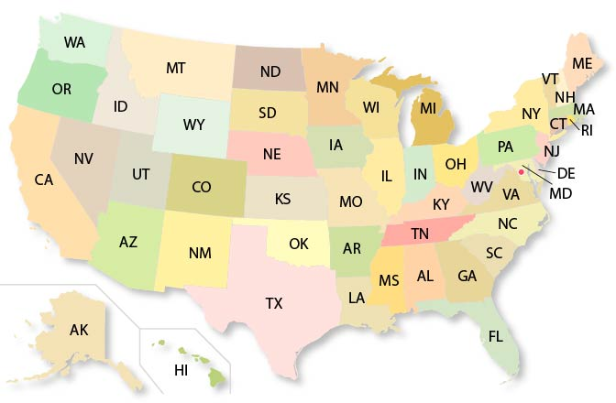
Dataset Description
Number of colonies
Number of colonies at the beginning of the quarter
Q1: January - March
Max number of colonies
Colonies plus all colonies moved into that state during the quarter
For each state in US:
Colony lost
Percentage and absolute values of colony lost
Q2: April - June
YEAR
from 2015 to 2022
Colony added
Colony that was either created or purchased
Q3: July - September
Colony renovated
Number of surviving colonies that were renewed
Stressors
Percentage of colonies affected by different types of stressors (1 feature each)
Q4: October - December
Diseases
Pesticides
Other
Varroa mites
$$N Colonies \left(t+1\right)= Max Colonies\left(t\right)−Lost Colonies\left(t\right)+Added Colonies\left(t\right) \text{± 2}\text{ \%}$$
x

Slide 4


Additional Data
Average
Maximum
Temperature
Minimum
Drought
PDSI
Possible explanatory factors
Precipitation
PM 10
Pollution
PM 2.5
Air Quality Index

Slide 5
X
1. DATA EXPLORATION

Slide 6
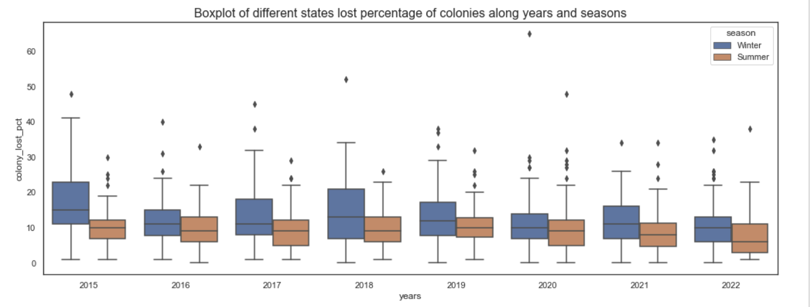
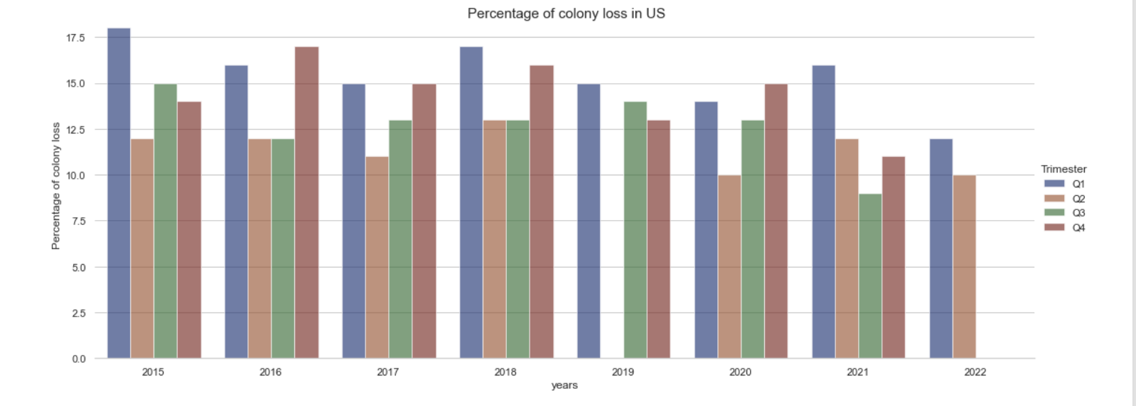
Analysis of seasonal periods
Two sample paired univariate permutation test in each year:
Significance difference at 5% between summer and winter in the following years:
2015, 2016, 2017, 2018, 2021, 2022
Notes:
First of all, we wanted to find out if there was a season or a year where the loss of colonies was particularly high.
Later, we will try to understand what generated these significantly higher losses
In particular, we performed a LOCAL PERMUTATIONAL TEST FOR DIFFERENCE IN COLONY LOST PCT POPULATION BETWEEN SUMMER AND WINTER

Slide 7
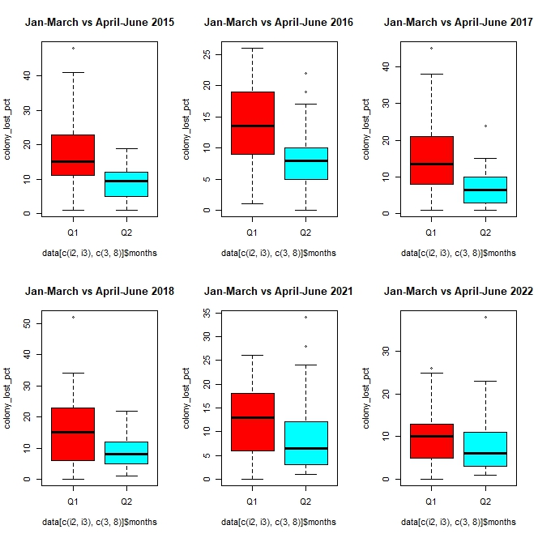
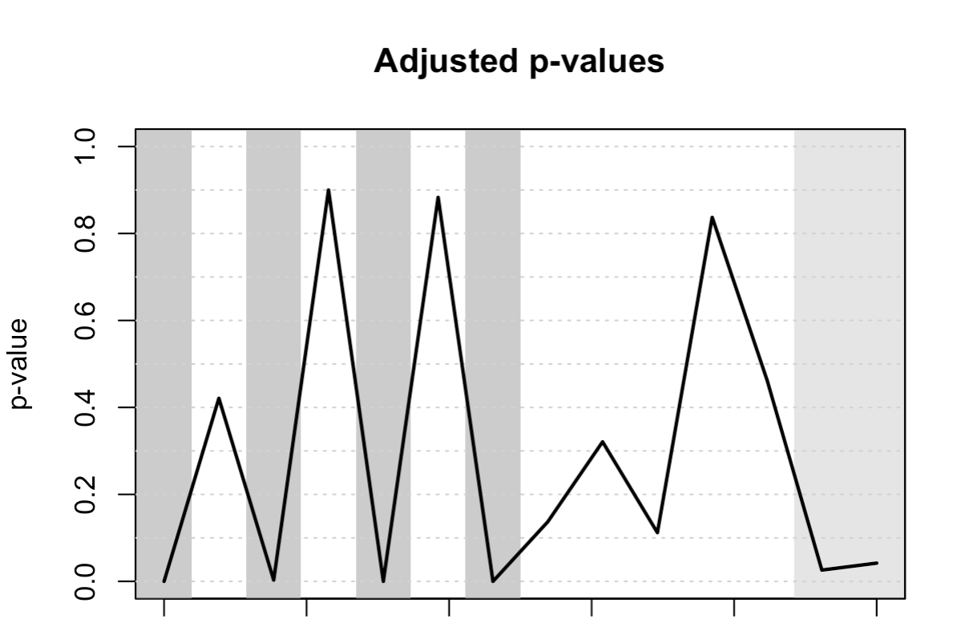
Analysis of seasonal periods
Global Permutational test for functional data: statistical evidence of difference in distribution between summer and winter.
Interval-wise testing:
Time
Local permutational test for difference in colony lost % between summer (functional data Q2-Q3) and winter (funtional data Q4-Q1)
Losses are higher in the quarter Q1 rather than in Q2 at 5% confidence [performing a two-sample paired permutation test on only these quarters]
Notes:
First of all, we wanted to find out if there was a season or a year where the loss of colonies was particularly high.
Later, we will try to understand what generated these significantly higher losses
In particular, we performed a LOCAL PERMUTATIONAL TEST FOR DIFFERENCE IN COLONY LOST PCT POPULATION BETWEEN SUMMER AND WINTER
We can see in grey the years where there is high statistical evidence that the losses are different
On the left, we can see the boxplot of these years for the first 2 quarters
Performing a two-sample paired multivariate permutation test on only these years, there is statistical evidence to state that the loss is higher in the quarter Q1 (January-March) rather than in Q2 (April-June)

Slide 8
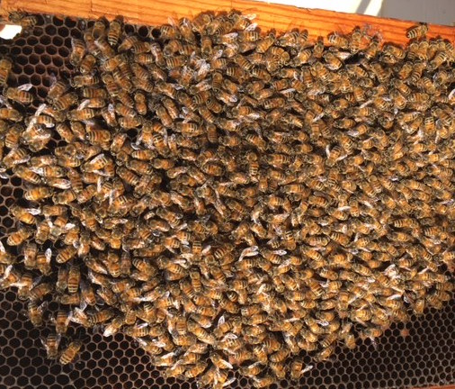
Cold winters DO NOT kill a healthy colony
According to our first analysis, winter is the season where bees are most at risk, but not only for the cold. Indeed, as soon as the temperature drops to below 10°C, bees come together to form what is known as the “winter cluster” (allowing them to stay at 25-30°C).
Colonies are lost during the winter due to viruses, parasites and diseases. Some of these virus are related to Varroosis. If the infestation by Varroa Mites is high at the beginning of winter and nothing is done to decrease it, their chances of survival can dramatically drop.
Notes:
The winter cluster becomes tighter and more compact as the ambient temperature drops further. Regardless of weather conditions, the temperatures within the winter cluster stay very warm at ca. 25-30°C.
Other winter problems can be pesticide build up in stored pollen, starvation or a failed queen.
parasites (as Nosema Apis)

Slide 9
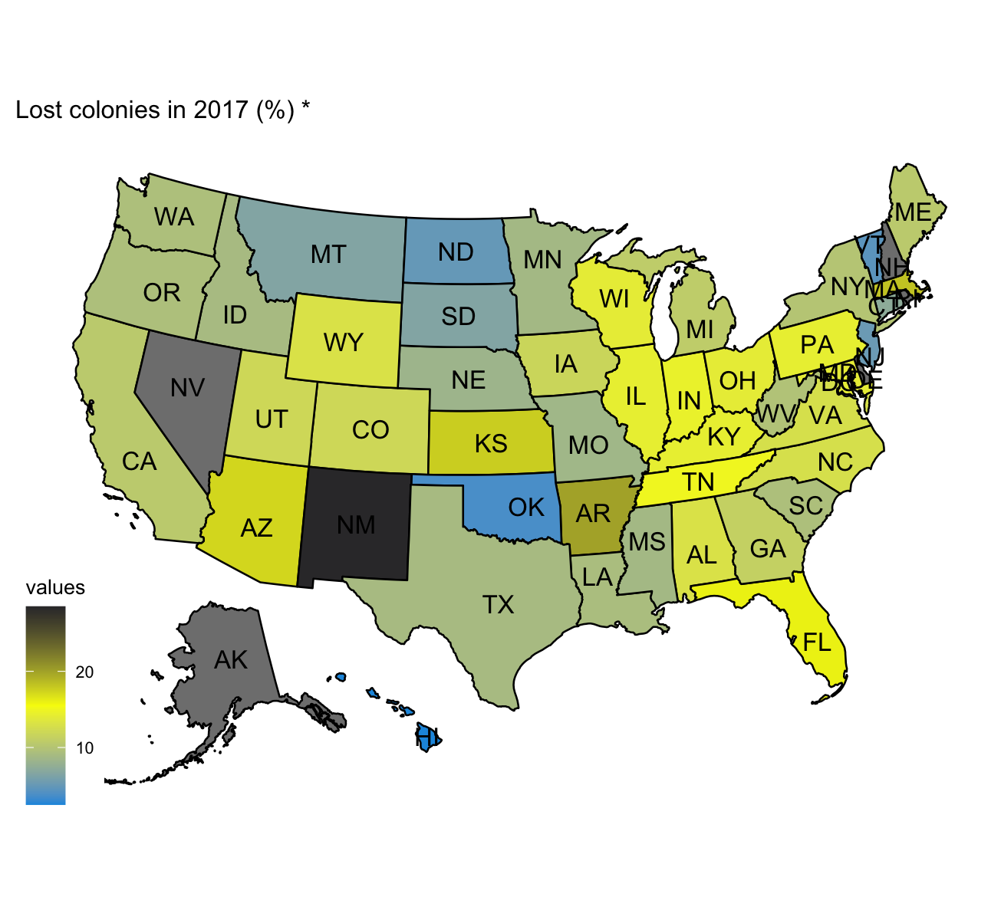
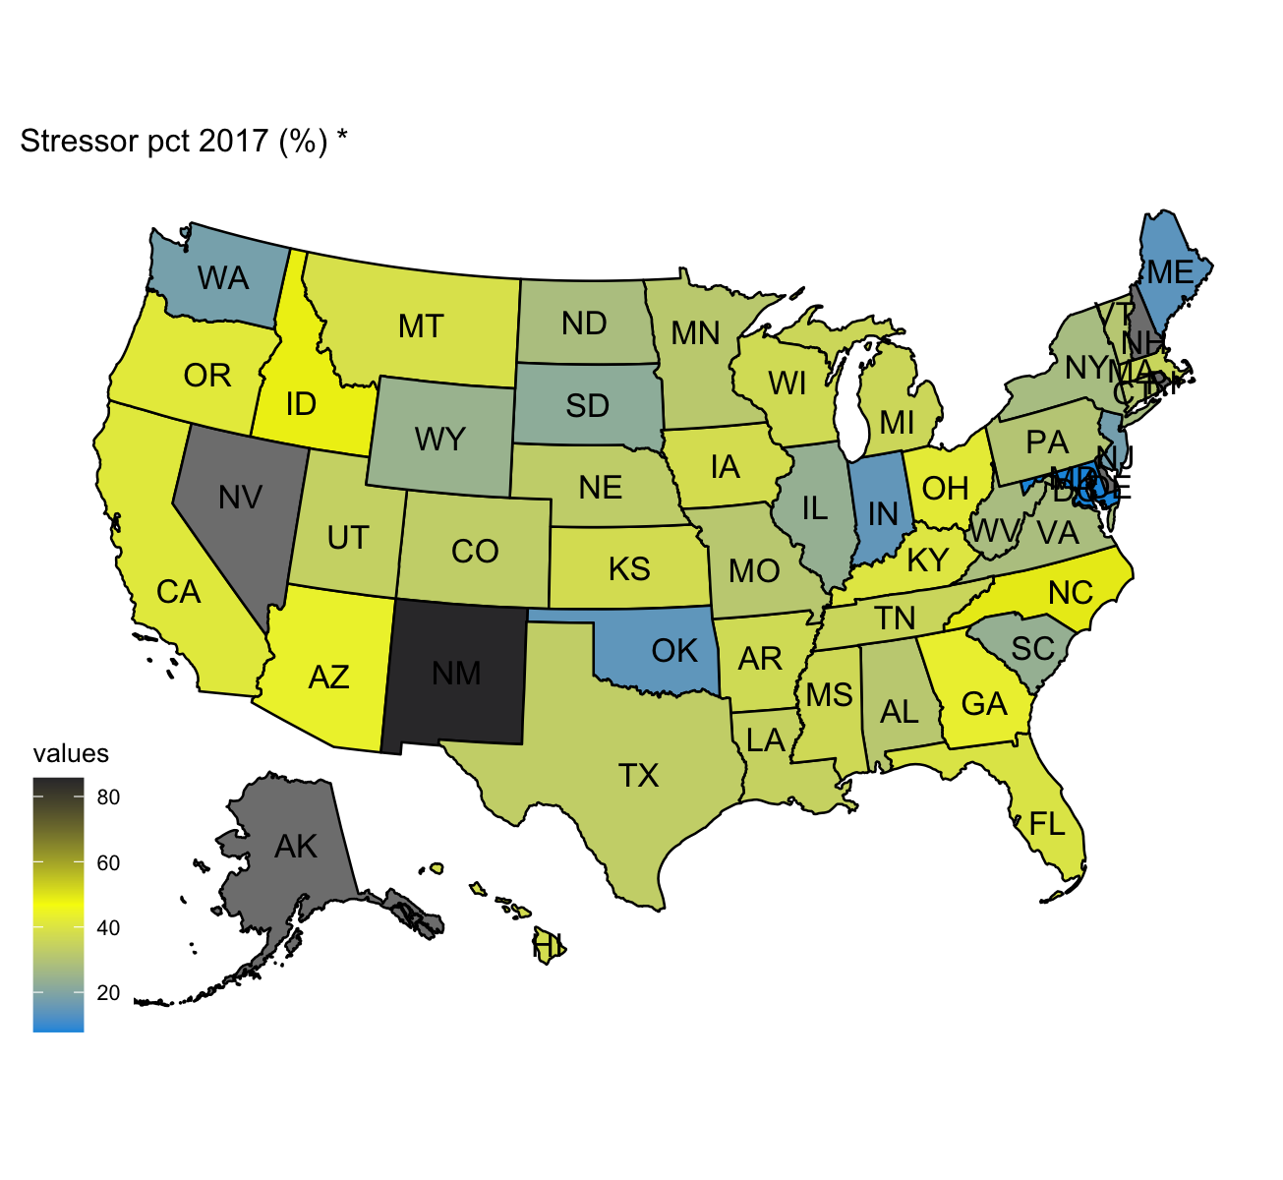
Are colonies losses correlated with Stressors?
Varroa Mites

Slide 10
Spearman correlation matrix
Functional data of states:
- Ordering with Modified Hypograph Index -
Median function of «unknown» stressor over the years seems to follows the pattern of the median of colony loss %
Notes:
In general, Spearman Correlations are not too high between stressors and colony lost pct.
The reasons might be different:
the effect of stressors might be lagged, meaning that the presence of stressors can influence on the losses in the following quarters and not necessarily just in the same quarter the stressors are detected
The values report the nonlinear influence of each single stressor on the loss percentage. As said at the beginning, none of them is the only reason of loss, but we know that their effects might be coupled and this is going to be studied in the regression model.
functional correlation we catch also longitudinal non-linear patterns in time, and here we see an higher coefficient for the correlation of colony loss percentage with the single stressors, in particular with unknown.
Each state represents a function over time
Spearm correlation matrix is computed with Modified Hypograph Index (MHI)

Slide 11
Varroa destructor: the most devastating honey bee pest
*
%
Notes:
The Varroa mite is the world’s most devastating honey bee pest.
Varroa is a highly efficient vector of honey bee viruses and drives changes in virus distribution, prevalence, and virulence.
Colonies with low infestation generally show very few symptoms, however as the mite population increases symptoms become more apparent. Heavy Varroa mite infestations can build up in 3–4 years and cause scattered brood, crippled and crawling honey bees, impaired flight performance, a lower rate of return to the colony after foraging, a reduced lifespan and a significantly reduced weight of worker bees. Colony symptoms, commonly called parasitic mite syndrome, include an abnormal brood pattern, sunken and chewed cappings and larvae slumped in the bottom or side of the cell. This ultimately causes a reduction in the honey bee population, supersedure of queen bees and eventual colony breakdown and death.

Slide 12
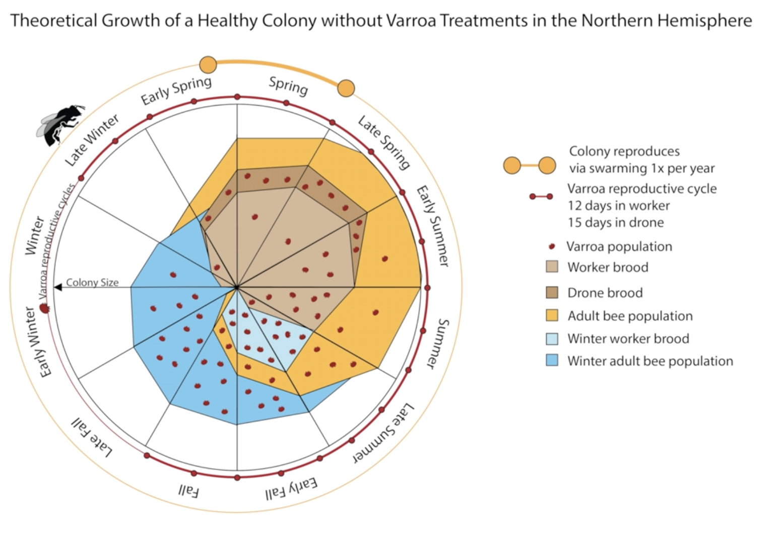
Varroa destructor: the most devastating honey bee pest
*
Varroa is a highly efficient vector of honey bee viruses and drives changes in virus distribution, prevalence, and virulence.
Heavy Varroa mite infestations can build up in 3–4 years
* Varroa destructor: A Complex Parasite, Crippling Honey Bees Worldwide, Kirsten S.Traynor et Al.
Notes:
The Varroa mite is the world’s most devastating honey bee pest.
Varroa is a highly efficient vector of honey bee viruses and drives changes in virus distribution, prevalence, and virulence.
Colonies with low infestation generally show very few symptoms, however as the mite population increases symptoms become more apparent. Heavy Varroa mite infestations can build up in 3–4 years and cause scattered brood, crippled and crawling honey bees, impaired flight performance, a lower rate of return to the colony after foraging, a reduced lifespan and a significantly reduced weight of worker bees. Colony symptoms, commonly called parasitic mite syndrome, include an abnormal brood pattern, sunken and chewed cappings and larvae slumped in the bottom or side of the cell. This ultimately causes a reduction in the honey bee population, supersedure of queen bees and eventual colony breakdown and death.

Slide 13
Influence of Varroa
Some states show similar patterns in overwintering reductions of bee colonies and number of stressed colonies by Varroa mites.
Outliers detection
Shape outlier: New Mexico
Notes:
Some states show a correlation between reductions in overwintering honey bee populations and Varroa mites
As we showed in the previous plots and is mentioned in literature, Varroa Mites is the most dangerous and most present stressor in bee colonies. We tried to explore and understand from a qualitative point of view if it really impacts the colony loss drastically more than the other stressors, and indeed we found some states in US with similar patterns in overwintering reductions of bee colonies and number of stressed colonies by Varroa mites. You can see in the plot the trends in New Mexico, the state with the highest peaks in colony loss which correspond to the highest peaks in Varroa.
This plot may anyway lead to the conclusion that Varroa Mites can always influence the loss by itself, which is against what is said in literature: “no single stressor alone seems to be responsible for the malady”.
And indeed this is confirmed by the Outliergram on the right: the case of new Mexico is a special one, this state is the only shape outliers detected studying the functional data of colony loss percentage, so it has a trend and phase variability which is unusual compared to the majority of states in US.
These analyses confirm that we cannot rely only on Varroa impact but we will need to study the combined effects that the stressors can have on the colony loss with a regression model.

Slide 14
2. ANALYSES OF CLIMATE INFLUENCE ON BEE’S HEALTH
X

Slide 15
Clustering states in 3 zones
Cluster 1: Alpine
Cluster 2: Continental
Cluster 3: Subtropical/ Mediterranean
Functional clustering by average temperature
Notes:
Functional clustering by univariate (fda cluster)
Purple is more or less related to subtropical or Mediterranean climate
Green to Continental
Orange to Alpine climate

Slide 16
% stressed by Varroa in groups
Notes:
(clust. By avg)
Data suggests that 1.varroa mites strike more warmer countries
2. raised seasonal temperatures reinforce autumn Varroa destructor infestation in bee colonies

Slide 17
Varroa winter infection in the different climate groups
two-sample independent permutation tests

Slide 18
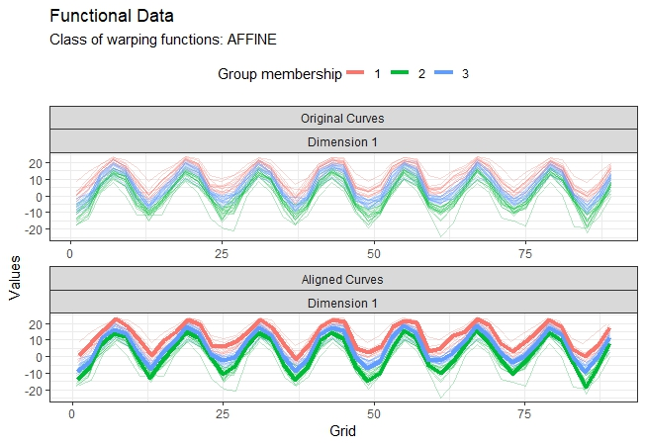
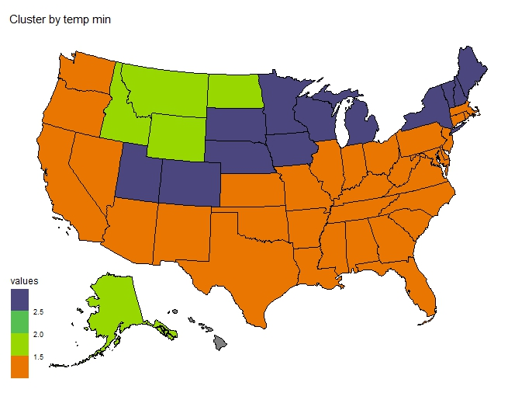
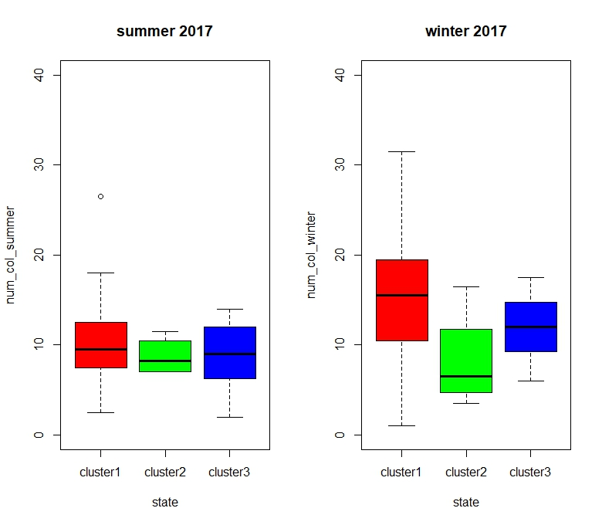
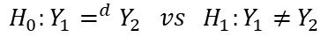
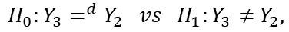
Cluster states into groups based on their climate
Cluster 1:Subtropical/ Mediterranean
Cluster 2: Alpine
Cluster 3: Continental
PERMUTATIONAL ONE-WAY ANOVA: Does the cluster by temp-min have an impact on the colony loss?
HYPOTHESIS: For each year we consider data (different states) within and between clusters as independent and identically distributed.
For all the winters, we have significance difference between the clusters, so we can perform two-sample independent permutation tests:
$$H_{0}:Y_{3}=^{d}Y_{2} vs H_{1}:Y_{3}≠{ Y}_{2},$$
$$H_{0}:Y_{1}=^{d}Y_{2} vs H_{1}:Y_{1}≠{ Y}_{2}$$
Notes:
ANOVA (permutational test)
ANOVA : does the cluster by temp min have an impact on the colony loss?
H0:τi=0 ∀i vs H1:∃τi≠0 i∈{1,2,3} The anova is significant if we consider just the quarter with low temperatures.
we can state that the loss of bees is lower in the cluster with the lowest temp min

Slide 19
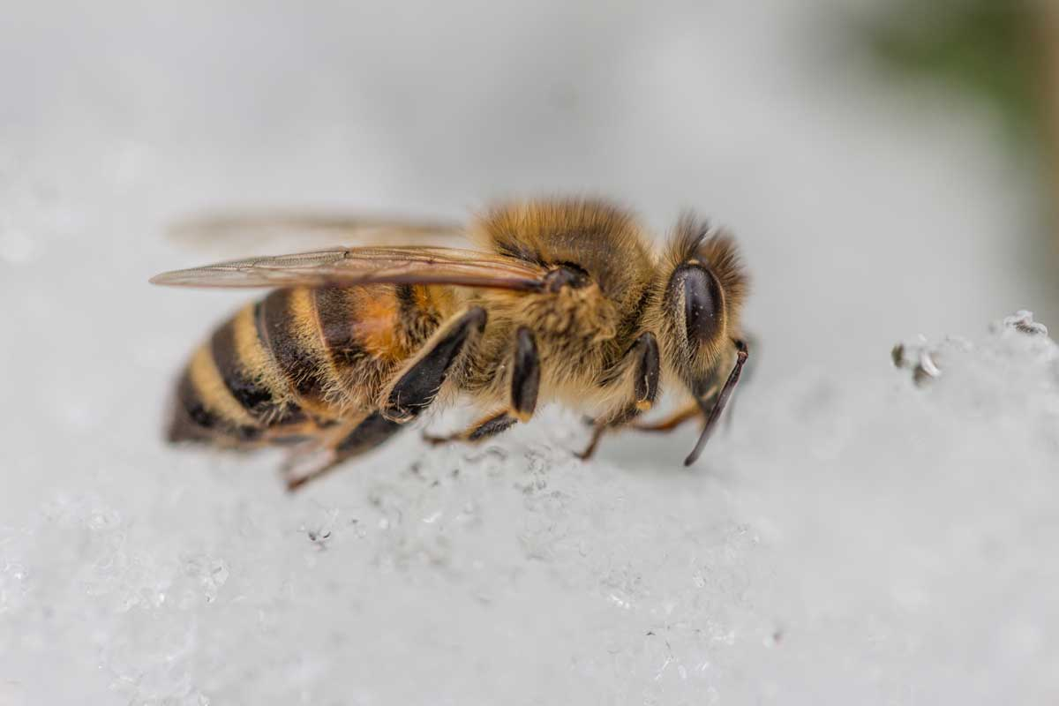
Extreme events and bee health
Previous researches showed that:
¹During late autumn, cold spells with adequate duration and intensity trigger colony wintering at the right time, reducing the likelihood of colony loss over winter.
²During winter, regular snaps of warm weather help bees to leave the hive and defecate. The more regular these mild winter weather conditions occur, the better the hygiene of the hive can be maintained
Mattila HR, Otis GW. 2007 Dwindling pollen resources trigger the transition to broodless populations of long-lived honeybees each autumn.
Sparks TH, Langowska A, Głazaczow A, Wilkaniec Z, Bieńkowska M, Tryjanowski P. 2010 Advances in the timing of spring cleaning by the honeybee Apis mellifera in Poland

Slide 20
X
3. A REGRESSION MODEL

Slide 21
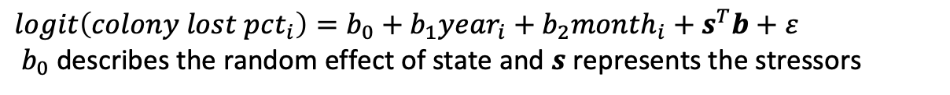
Semiparametric Regression
GENERAL IDEA:
Parametric part to interpret
Non-parametric part:
Tensor-product space⊗time (e.g. using thinplate splines and fourier-basis)
We tried some models like:
$logit\left(colony lost pct_{i}\right)=b_{0}+b_{1}year_{i}+b_{2}month_{i}+s^{T}b+ε$
$b_{0}$ describes the random effect of state and $s$ represents the stressors
Notes:
Our goal for the part of the regression is to fit a semiparametric model.
In particular, we thought about a parametric part, which should be interpretable - we would like stressors to be part of it - so that we can draw conclusions on how to act to reduce the colony losses.
On the other part we think that a non-param part would be useful (or necessary?) to include the spatio-temporal essence of our data.
We can handle the parametric part using tools Applied Stat, whereas, for the non-pa part we may use a tensor-product between spatial basis and temporal basis (e.g thinplate x fourier).
For the non-parametric part we will try to use the package mgcv (penalized Generalized Linear models including Generalized Additive Models and Generalized Additive Mixed Models).
GOALS: Esplorare relazione che c'è tra colony lost wrt stressori e condizioni climatologiche (dettate dal periodo dell'anno e dalla posizione dello stato), in modo da consigliare agli apicoltori una strategia per arginare il problema della perdita di colonie -> Aggiuntivo: forecasting

Slide 22
NEXT STEPS AND POSSIBLE IMPROVEMENTS
Functional outlier detections: curves need to be smoothed. It would be possible also to register them before checking amplitude outliers.
Missing values for 2019-Q2: fit a SARIMA model to retrieve this information and perform functional data analysis.
Improvements in regression models.
Conformal prediction: predict future values and understand possible precautions that can be taken.
Survival Analysis: cumulative percentage decrease along semesters and considering the «time to event» as the time when the decrease is below 10%.
Notes:
Conformal prediction: stimare andamento futuro dell’andamento di morte
Survival Analysis: check the cumulative percentage decrease in the population and as event of death we consider when this decrease goes below 10%.

Slide 23
THE END

Slide 24
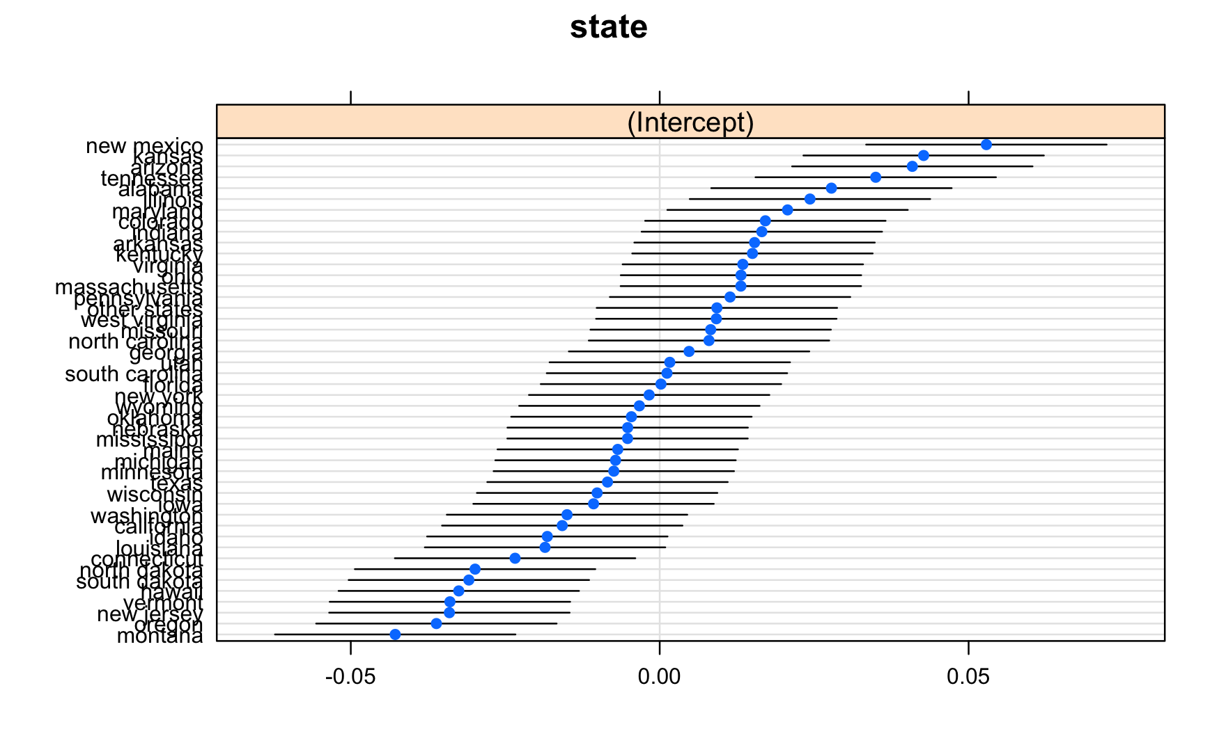
LINEAR MIXED MODEL

Slide 25
LOGIT MIXED MODEL

Slide 26
LOGIT MIXED MODEL

Slide 27
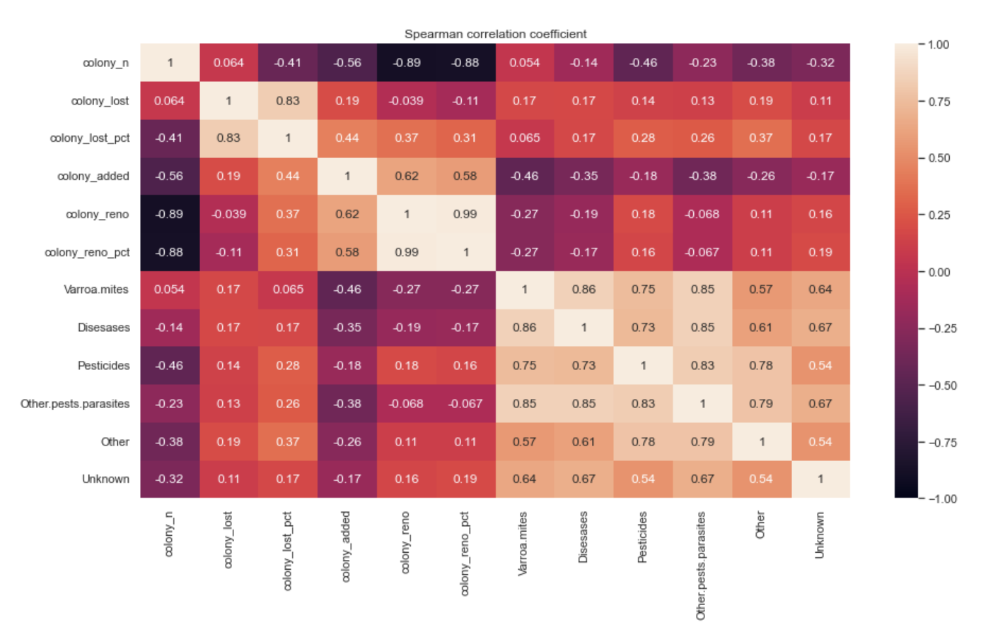
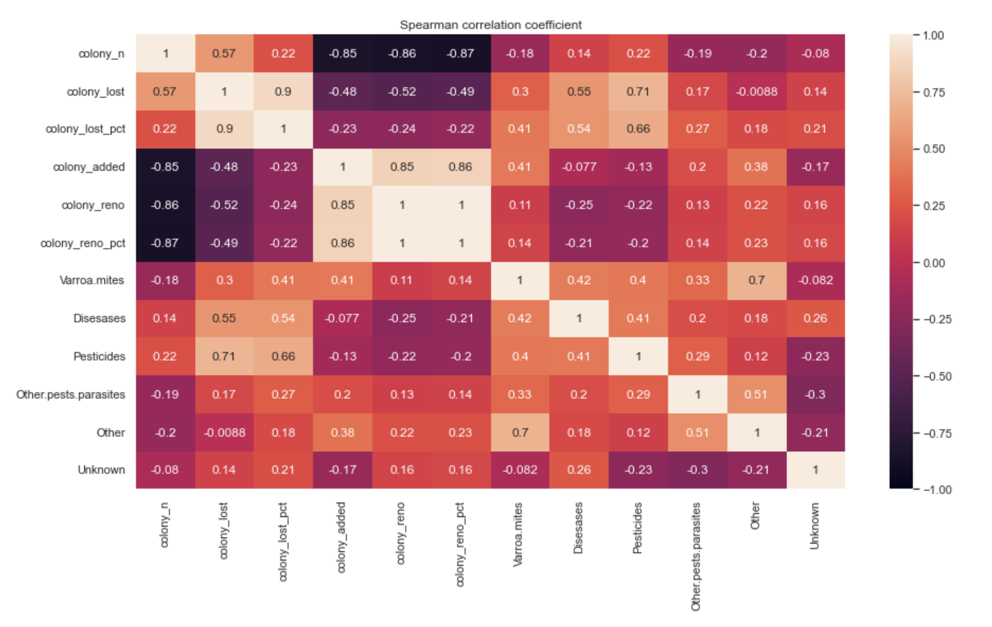
Spearman correlation – Winter - US
Spearman correlation – Summer - US
Notes:
In general, Spearman Correlations are not too high between stressors and colony lost pct.
The reasons might be different:
the effect of stressors might be lagged, meaning that the presence of stressors can influence on the losses in the following quarters and not necessarily just in the same quarter the stressors are detected
The values report the nonlinear influence of each single stressor on the loss percentage. As said at the beginning, none of them is the only reason of loss, but we know that their effects might be coupled and this is going to be studied in the regression model.

Slide 28
Pesticides and Diseases are strongly correlated with Summer US colony losses (%)
Notes:
However, considering summer, Pesticides and Diseases are strongly correlated with Summer US colony losses

Slide 29
Spearman correlation – Winter - US
Spearman correlation – Summer - US
Varroa mites infestation is correlated with the presence of diseases, other parasites and pesticides
Notes:
In addition, we can see a general correlation between stressors, especially during summer
Varroa mites infestation is correlated with the presence of diseases, other parasites and pesticides

Slide 30
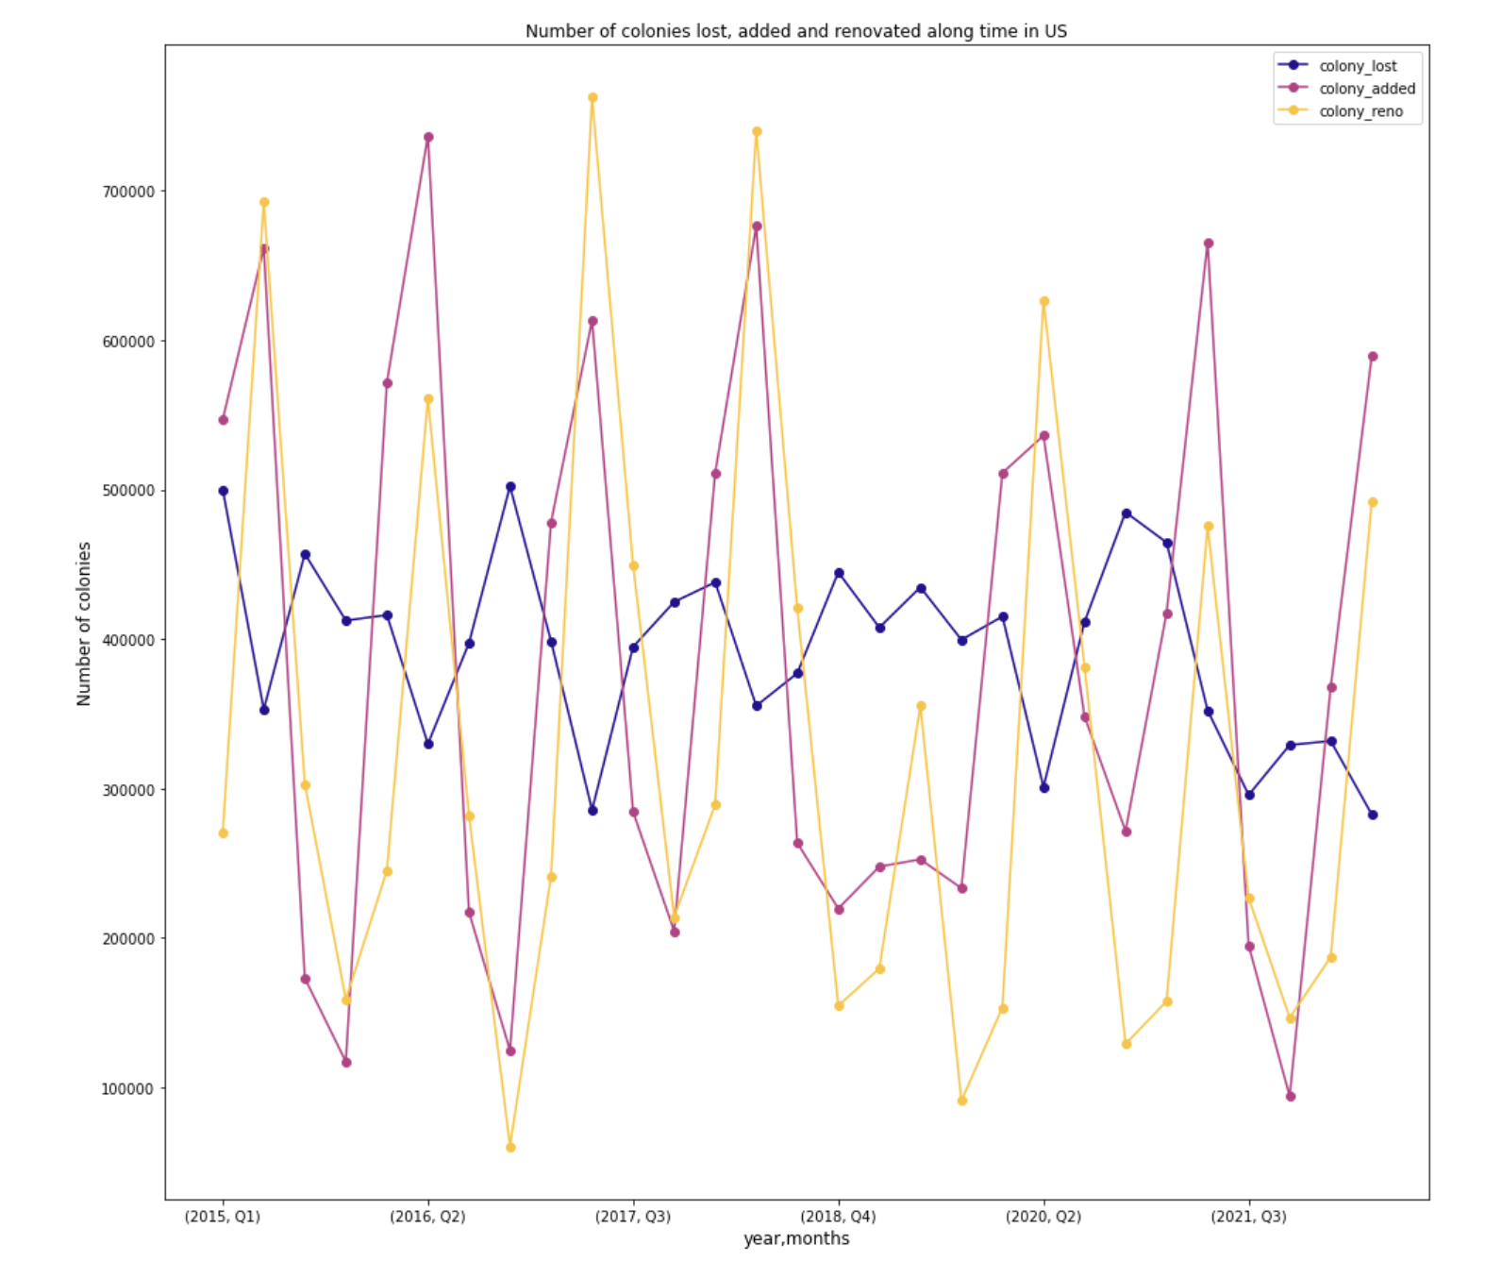
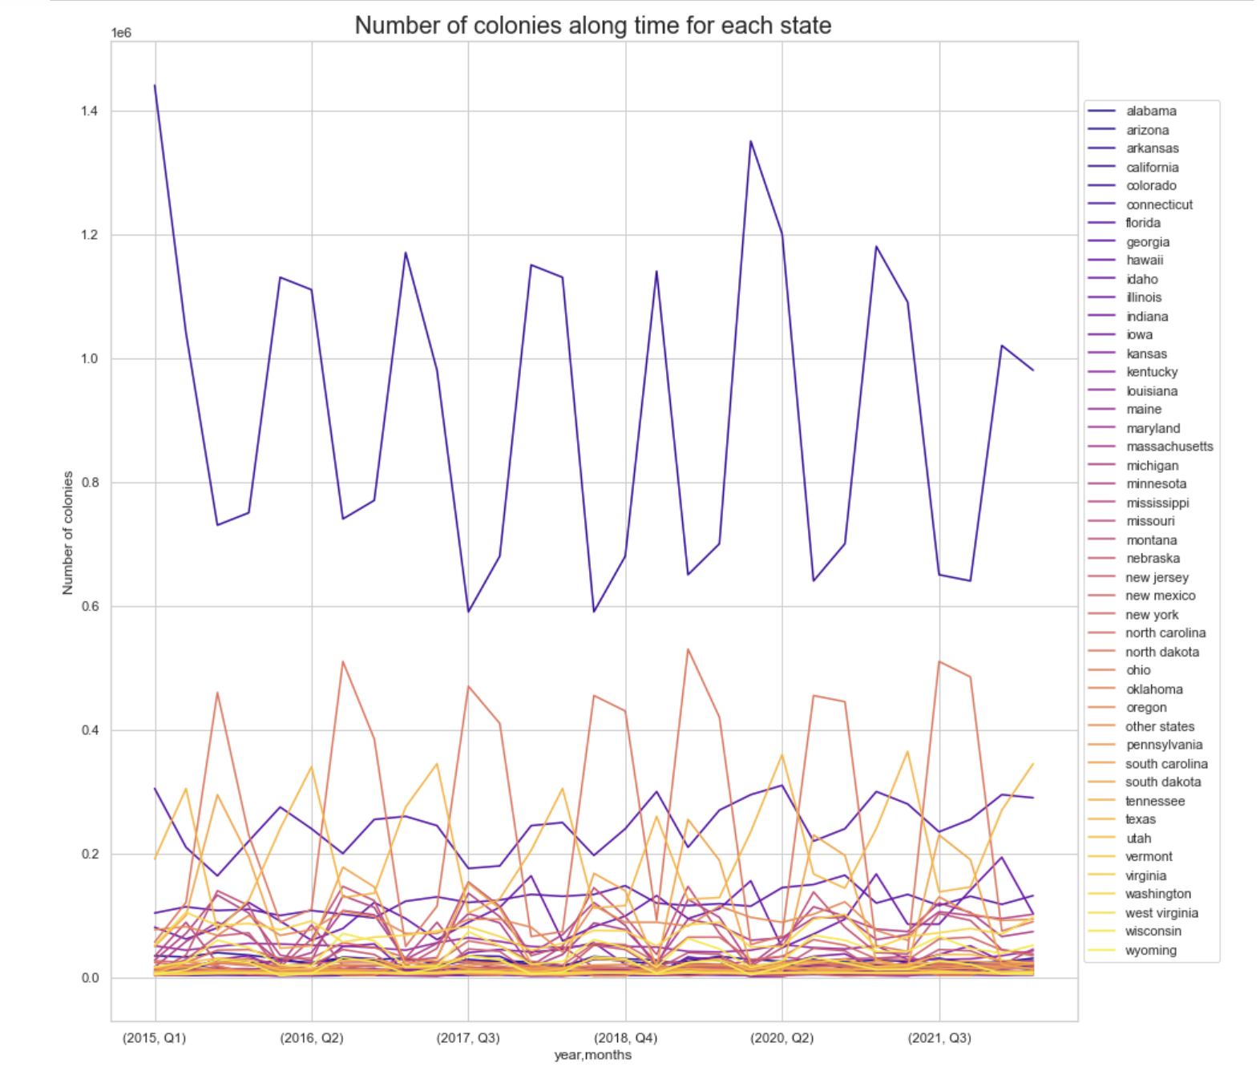

Slide 31
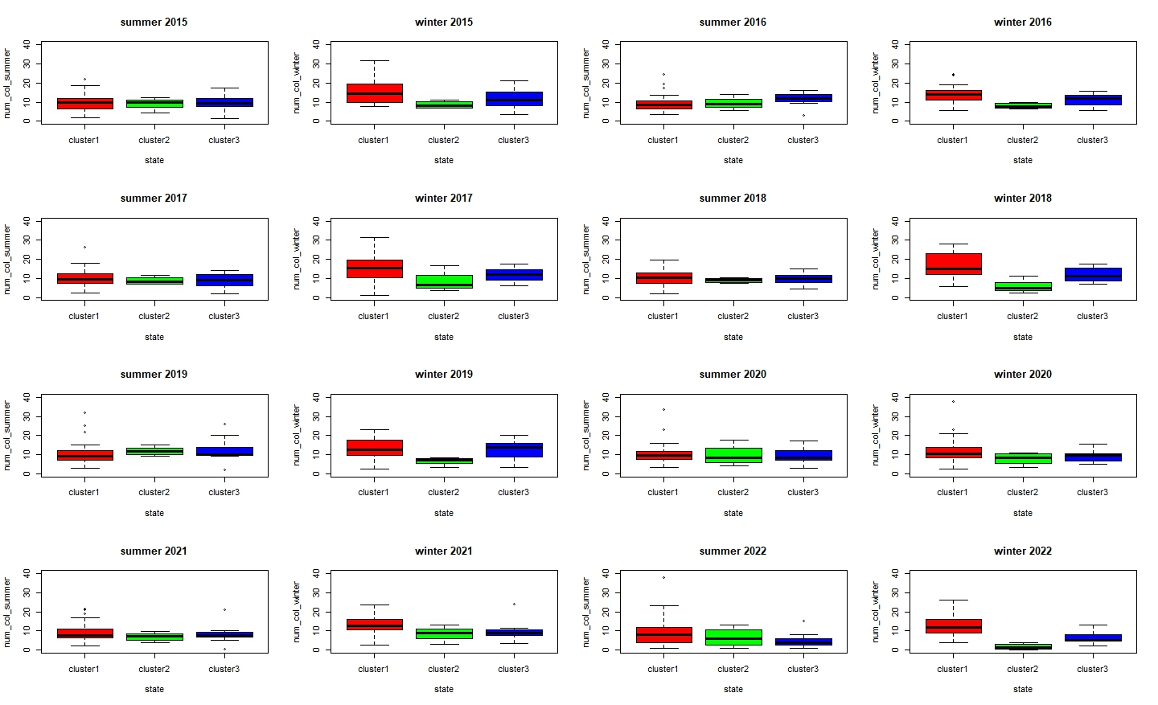
% losses in groups - winter and summer
Notes:
Autunno: se sono troppo caldi, le api sono troppo attive -> stacncano e consumano provviste e quindi inverni stanchi senza provviste
Inverno: se ci sono un po' di giorni caldi meglio così le api possono andare fuori e mantenere pulito alveare -> ridotto rischio di infezioni
- Cluster by temp min

Slide 32
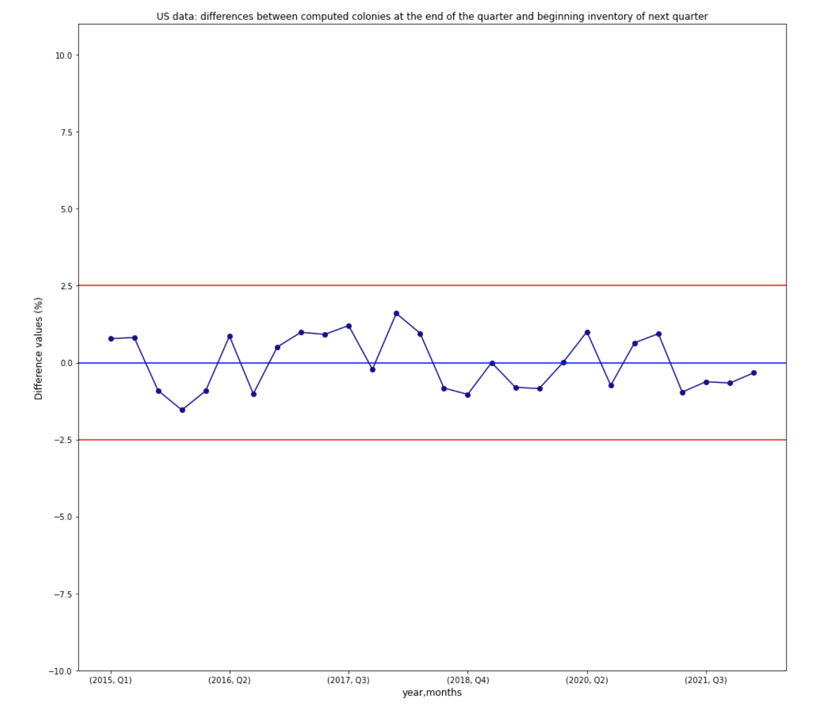
Understanding the data
$$N Colonies \left(t+1\right)= Max Colonies\left(t\right)−Lost Colonies\left(t\right)+Added Colonies\left(t\right)$$
Assumptions:
No colonies are moved out US.
The maximum number of colonies in a state can vary widely during a quarter and throughout the year because colonies are moved for pollination.
US data: differences between computed colonies at the end of the quarter and beginning inventory of next quarter
Notes:
Data are obtained through a survey
While some colonies in the U.S. are primarily honey producing colonies and usually remain in one state, other colonies are primarily used for pollination purposes. Pollinating colonies are moved from state to state throughout the year following the crops that need to be pollinated. Therefore, the maximum number of colonies in a state can vary widely during a quarter and throughout the year. For example, on an individual record level an operation could not have any colonies in North Dakota at the beginning of a quarter because all of their colonies are in California for almond pollination. But during the middle of the quarter the almond pollination season ends and the colonies are moved back to North Dakota.
If no colonies are moved out of state, then the calculation above should be within 2% of the starting inventory of the following quarter. These small differences are mainly due to memory errors or miss of precision in filling out the survey.

Slide 33
Spearman correlation matrix
 | Colony lost pct | temp mean | temp max | temp min | precipitations
Colony lost pct | 1.00000000 | 0.3241109 | 0.3553618 | 0.2643499 | -0.03560824
temp mean | 0.32411093 | 1.0000000 | 0.9688404 | 0.9837818 | 0.58896067
temp max | 0.35536178 | 0.9688404 | 1.0000000 | 0.9155325 | 0.40713594
temp min | 0.26434992 | 0.9837818 | 0.9155325 | 1.0000000 | 0.68301644
precipitations | -0.03560824 | 0.5889607 | 0.4071359 | 0.6830164 | 1.00000000
Notes:
Non la mettiamo

